Slide 1
ASE456: Individual Project
By: W. Brooks Arthur

Slide 2
List of Features
Time Recording
Time Querying
Generation of Usage Report
Generation of Priority Report
2

Slide 3
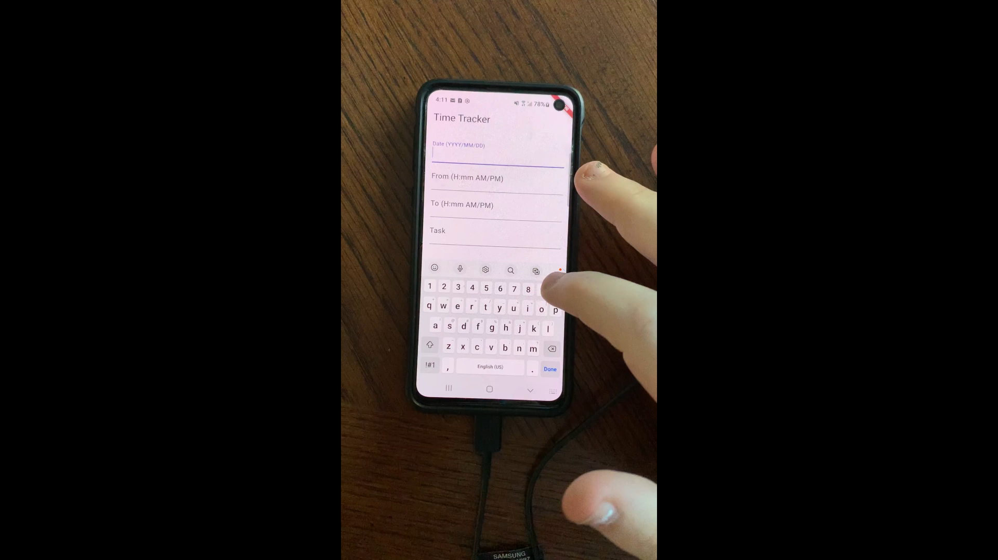

Slide 4
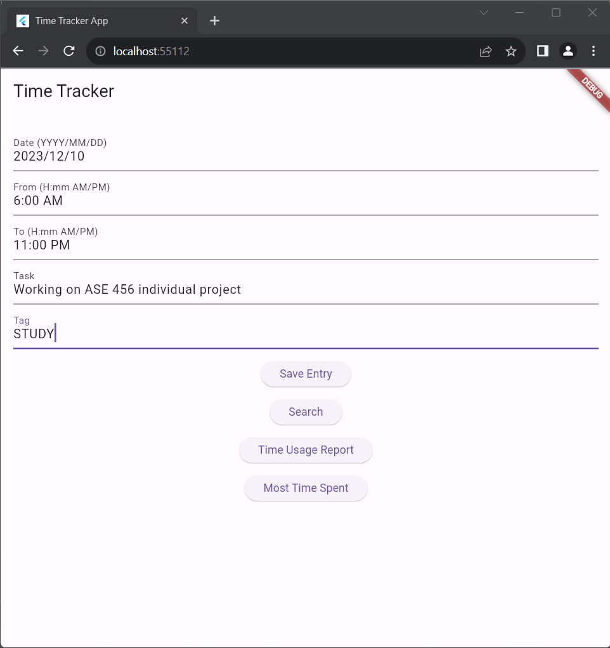
Time Recording
User Is able to input date, start time, end time, task, and tag and submit data to a Firebase database.
4

Slide 5
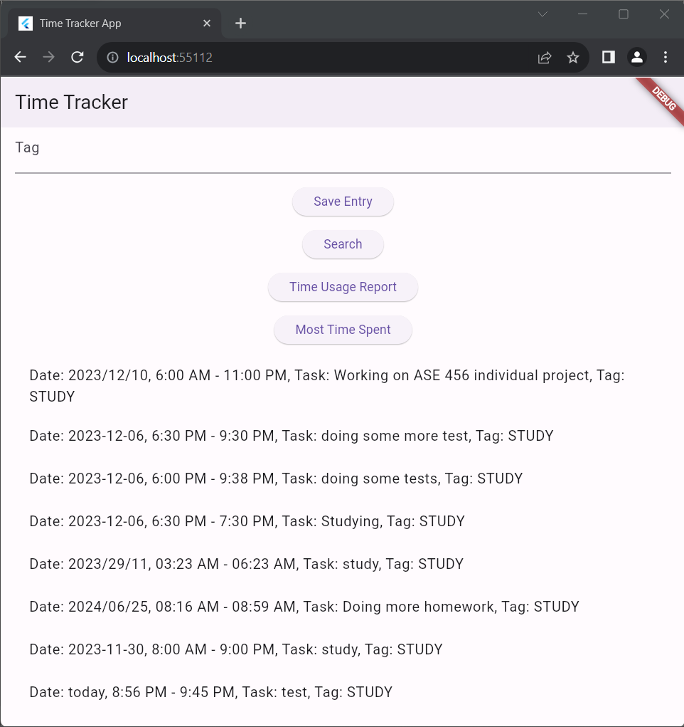
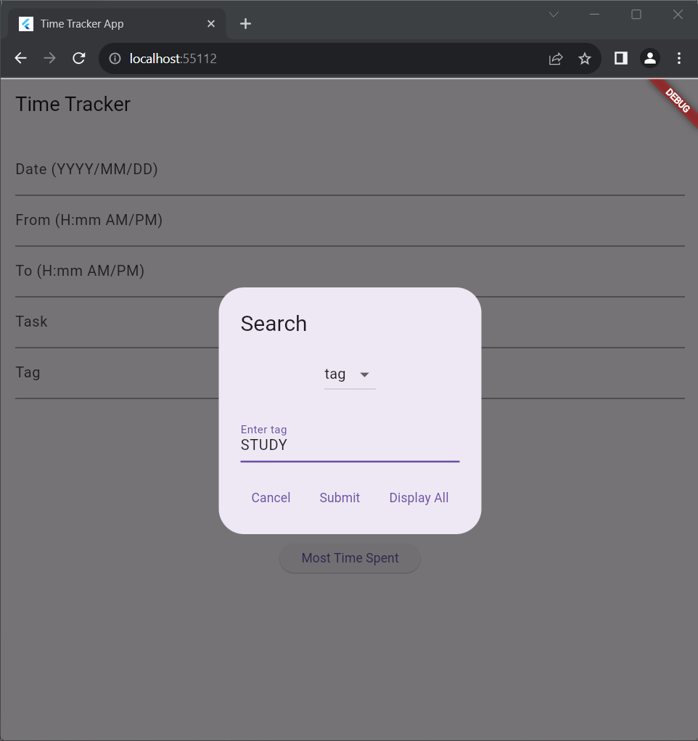
Time Querying
User can query database based on date, task, or tag.

Slide 6
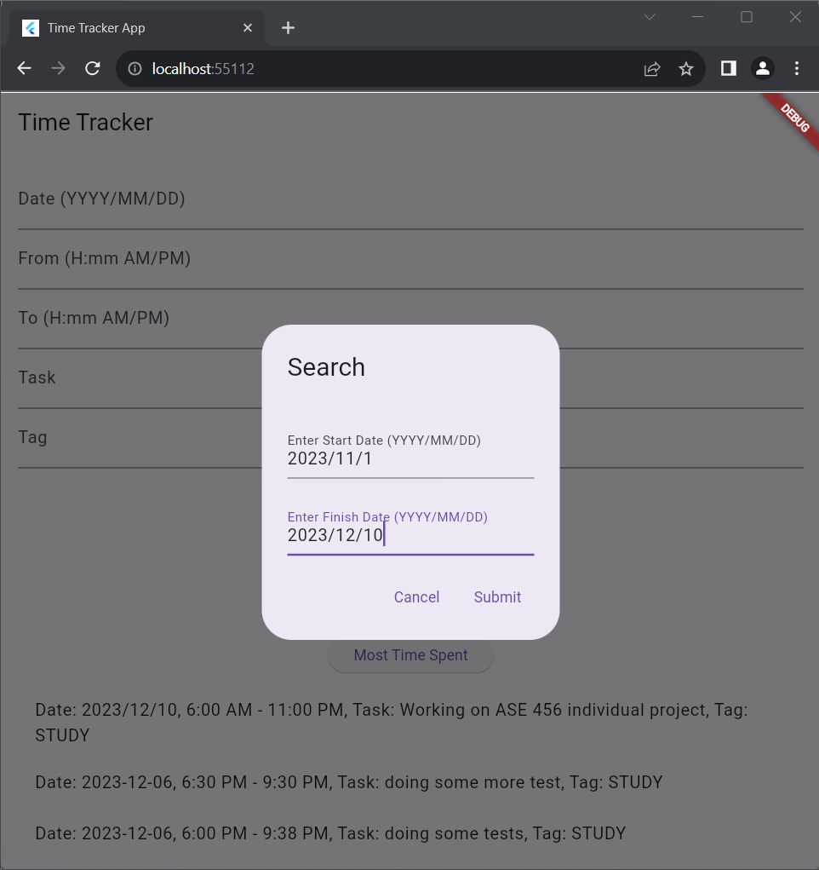
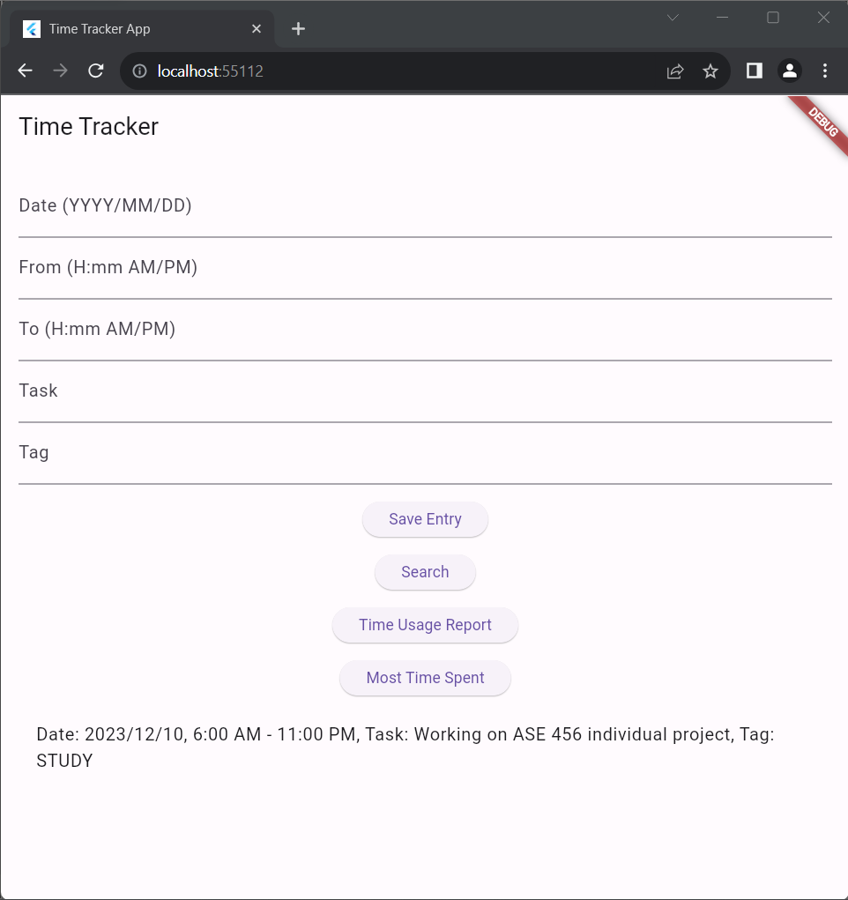
Generation of Usage Report
User can get a usage report by inputting two dates.
Usage report will output all entries between those dates.

Slide 7
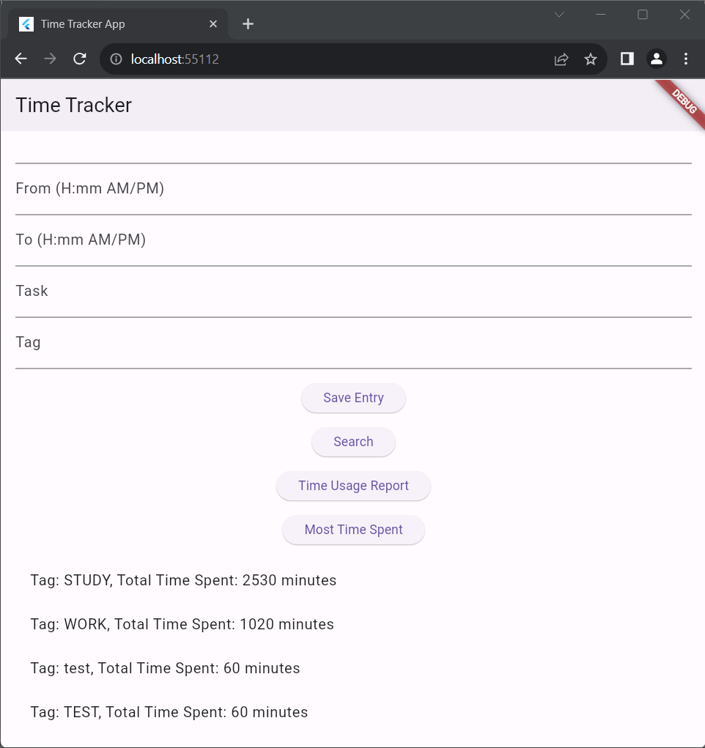
Generation of Priority Report
User can press priority report button to receive a list of their most used tags.
Application will output tags with their total time spent.
7

Slide 8
Total Lines of Code: 707
Main: 408
Unit Tests: 167
Firebase: 63
Acceptance Test: 45
Utility Code: 24
8

Slide 9
Testing Breakdown
Unit Tests: 6
Regression Tests: 2
Acceptance Tests: 1
8/9 tests have passed.
9

Slide 10
What I Learned
I learned how to program and application with a focus on cross-platform development.
I learned how to learn new tools in a short amount of time.
I learned how to manage time to finish features on time and on budget.
10

